Slide 1
Team 8 AI BASED PNEUMONIA DETECTION

Slide 2
Problem Statement
Healthcare providers, particularly in small to medium-sized hospitals and diagnostic centers in resource-scarce regions, face significant challenges in diagnosing pneumonia accurately and efficiently. This is primarily due to a high workload, limited availability of radiologists, and human fatigue, which can lead to delayed or inaccurate diagnoses. These factors create a bottleneck in diagnostic throughput, potentially impacting patient outcomes by delaying treatment.

Slide 3
Product/ Solution - Innovation
Innovation and Problem Solving
Our innovation is a sophisticated, AI-powered web platform designed to analyze lung scans and accurately detect pneumonia. It utilizes a highly accurate, pre-trained TensorFlow model integrated into a modern web application.
This platform directly addresses several critical problems in the healthcare sector:
Reduces Diagnostic Errors & Delays
Alleviates Workload
Improves Patient Outcomes
Eases Integration

Slide 4
Product/ Solution - Innovation
Type of Innovation
This innovation is best described as an incremental improvement to existing AI-driven diagnostic solutions.
The document acknowledges that a key challenge for hospitals is the "Limited adoption of AI-driven tools and difficulty integrating them into existing hospital workflows". This implies that AI diagnostic tools already exist. Our platform improves upon these by focusing on accessibility, usability, and seamless integration, making a powerful technology practical for a wider range of healthcare providers

Slide 5
Product/ Solution - Innovation
Unique Differentiators
Our platform is unique when compared to other solutions in the following ways:
Focus on Seamless Integration: We prioritize easy integration into existing hospital IT systems. Our solution is built with a modern tech stack (React, FastAPI) and offers an API, PostgreSQL database access, and JWT authentication for secure, straightforward implementation.
Target Market Specialization: Our primary focus is on small to medium-sized hospitals, diagnostic centers, and research labs. We are specifically tailored to serve developing regions where there is a scarcity of radiologists, a market often overlooked by larger enterprise solutions.
Comprehensive, User-Friendly Platform: We offer a complete, end-to-end solution. It's not just an AI model; it's a full-stack application with a user-friendly frontend and a robust backend that includes features like automated email and PDF reporting. This makes the tool immediately usable without requiring extensive in-house development.

Slide 6
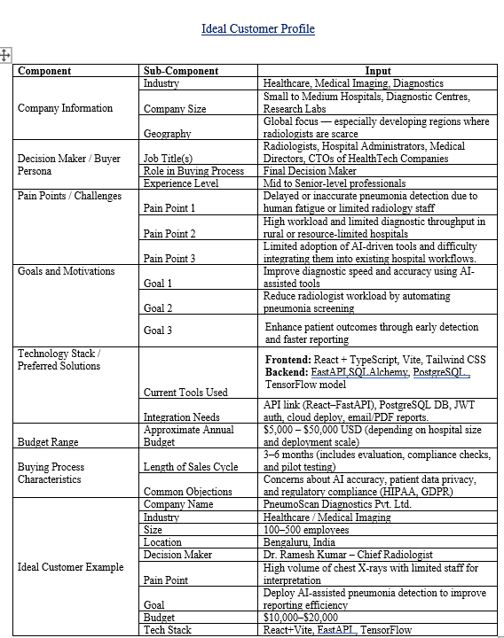
Product/ Solution - Readiness Level

Slide 7
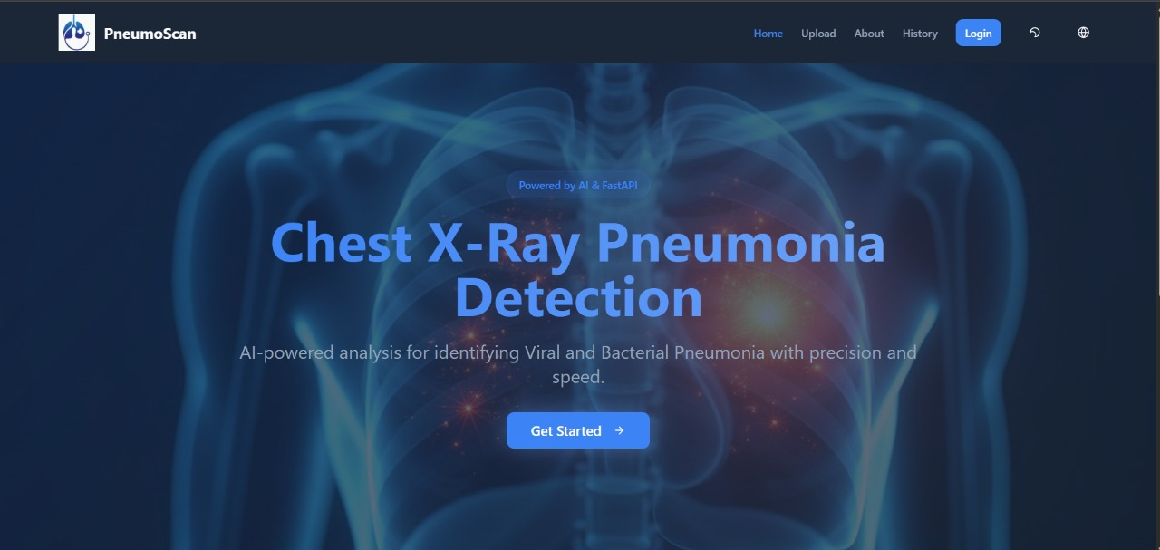
Product Images
PRODUCT IMAGES

Slide 8
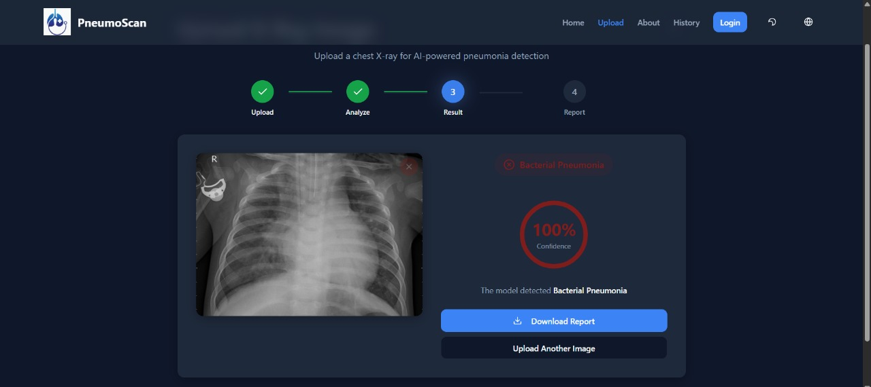
Product/ Solution - Readiness Level
PRODUCT IMAGES

Slide 9
Team Size, Background, Strength /Capability and Resources
Background: Computer Science / AI & Data Science students with skills in full-stack and machine learning development Strength
Capability: Expertise in React, FastAPI, and AI model integration Strong collaboration and problem-solving skills Focused on building a reliable and aesthetic medical AI solution
Resources: Kaggle dataset (Chest X-Ray Pneumonia)
Development tools: VS Code, GitHub, Python, React, PostgreSQLCloud platforms: Supabase / AWS for deployment

Slide 10
Market Landscape - Market Potential, Competitors
Market Size & Potential
Annual Spend Per Customer: Our target customers have an approximate annual budget of $5,000 – $50,000 USD , depending on the size of the hospital and the scale of the deployment
Market Potential: The market consists of Small to Medium Hospitals, Diagnostic Centres, and Research Labs globally. Our primary focus is on developing regions where there is a scarcity of radiologists
Competitive Landscape
Competitors: The market includes existing providers of AI-driven diagnostic tools. A key challenge we address is the difficulty hospitals face when integrating these existing solutions into their workflows

Slide 11
Market Landscape - Market Potential, Competitors
Our Uniqueness:
Seamless Integration: We offer an API, direct PostgreSQL database access, and JWT authentication for easy integration into existing hospital systems
Niche Focus: We are specifically tailored for small to medium-sized institutions in resource-limited regions, a market often overlooked by larger vendors
Accessible Pricing: Our flexible pricing model makes advanced AI technology financially accessible to smaller organizations
Complete Solution: We provide a full-stack, user-friendly platform with a React frontend and automated email/PDF reporting, making it immediately usable without extensive development

Slide 12
Business Model & Strategy
Revenue Model
Model: Our revenue model is a B2B annual subscription.
Pricing: We will offer tiered annual subscriptions ranging from INR 5,000 to 50,000 . The final price is determined by the customer's size and the scale of their deployment.
Business Model Drivers
Annual Recurring Revenue (ARR): The core of our business model is generating predictable ARR from annual contracts with hospitals and diagnostic centers
Key Revenue Drivers: Pricing tiers are primarily driven by
Customer Size: Small, medium, or large hospitals/centers will have different subscription levels
Deployment Scale: The volume of scans, number of users, or extent of integration will influence the annual cost

Slide 13
Total Budget, Required Support and Regulation
Funds Raised to Date: This project has been bootstrapped to the current concept and wireframing stage. We have not raised any external capital to date.
Current Ask: We are seeking $[Amount] in [Seed/Pre-Seed] funding.
Use of Funds: The funds will be allocated to:
Product Development: Build and launch the Minimum Viable Product (MVP) based on our existing technical architecture and wireframes.
Pilot Program Launch: Initiate pilot tests with target hospitals to validate the product and gather critical feedback. The sales cycle is estimated to be 3–6 months.
Regulatory Compliance: Ensure the platform meets data privacy and security standards such as HIPAA and GDPR, which are common customer concerns.
Future Funding Plans: After successfully launching the pilot programs and securing initial customers, we plan to raise a Series A round to scale our sales and marketing efforts globally, with a focus on developing regions.
.

